Slide 1
UBER CASE STUDY SUBMISSION

Slide 2
Abstract
Business Objective:
Identify the root cause of problem (i.e. cancellation and non-availability of cars) and recommend ways to improve the situation.
Data Source:
Masked data set which is similar to what Uber handle in real life scenario.

Slide 3
Data Preparation
Request Time splitted into separate Date and Time columns
Date format standardized for Request and drop timestamps.

Slide 4
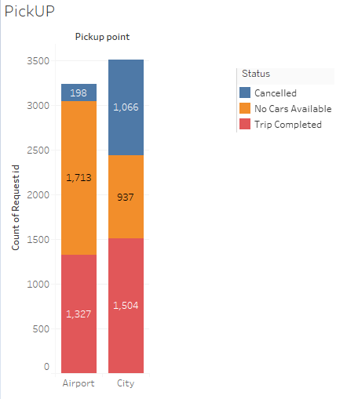
Analysis – PickUp Point
No. of Trips from City To Airport are more compared to Airport to City.
No. of Trips 'Completed' from City To Airport are more compared to Airport to City.

Slide 5
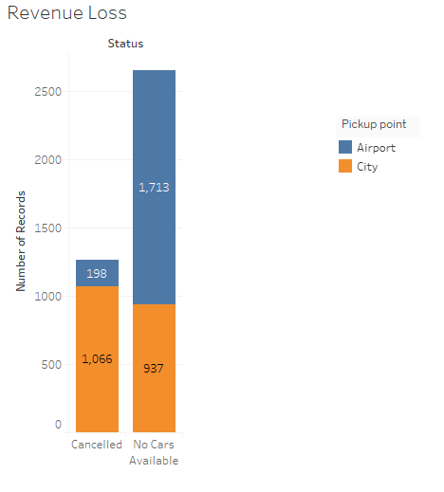
Analysis – PickUp Point
No. of Trips from City To Airport are “Cancelled” more.
No cars available at Airport leading to revenue loss.

Slide 6
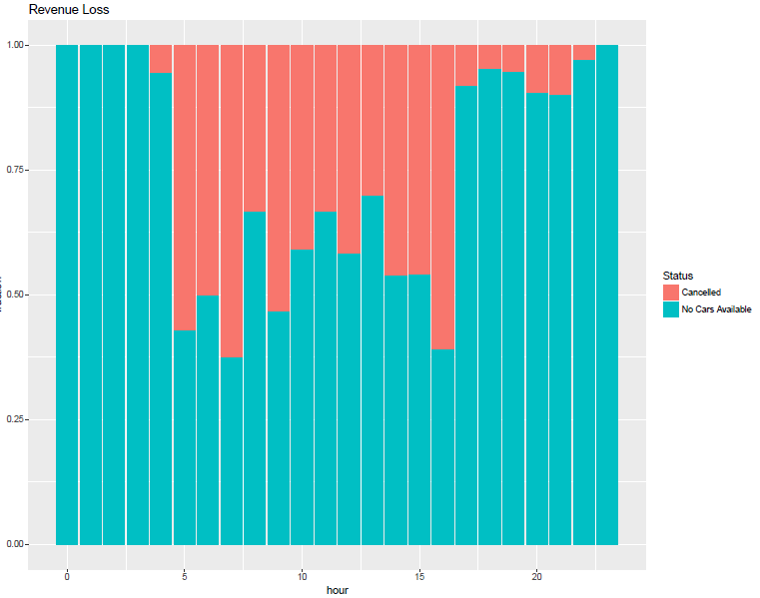
Analysis – PickUp from Airport
Huge Supply Demand gap from Airport pickup point
Supply Demand gap starts increasing after roughly 4 PM and drops at 11 PM.

Slide 7
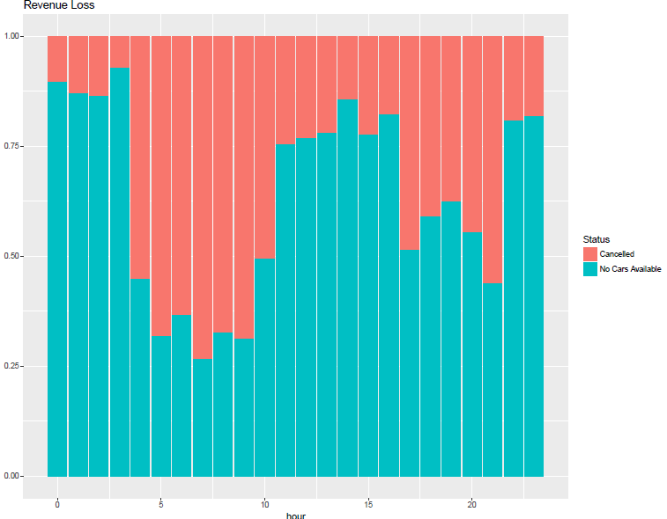
Analysis – PickUp from City
There are more Cancellations compared to 'No Cars Available'.
50% or more of revenue loss between 4 AM till 10 AM is because of 'Cancelled' trips
Trips cancelled more than 50% at 17 and 21 hours in a day.
Driver with ID ‘84’ cancels highest no. of trips. Top 5 drivers who cancel trips:
# 1 84 11
# 2 54 10
# 3 142 10
# 4 27 8
# 5 131 8

Slide 8
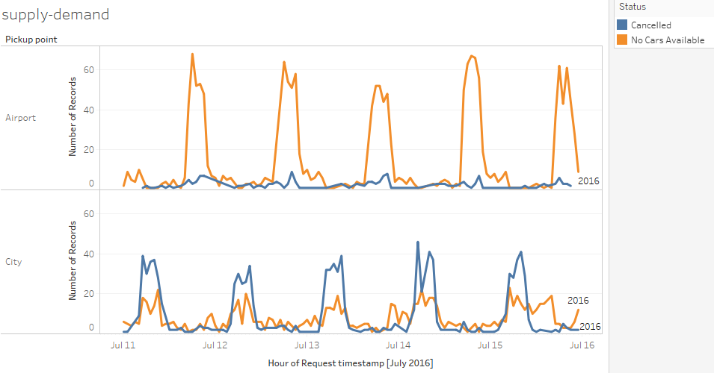
Reasoning
Airport to City:
There are not much requests coming from City To Airport from 4 pm till 11 pm onwards.
To take a pickup from Airport, a driver needs to drive taxi without any passenger most likely from city to Airport.

Slide 9
Reasoning
City To Airport:
There are not much requests coming from Airport to City from 4 AM till 10 AM onwards.
To take a pickup from City to Airport, a driver needs to drive taxi without any passenger most likely.

Slide 10
Recommendations
Taxi Parking Hub:
Make a Taxi Parking hub midway between City and Airport for hours: 4AM till 10 AM and 4PM
till 11 PM. This will reduce cost of driving without passenger either way.
Profit sharing/Other incentives:
Devise some profit sharing schemes or other incentives for completing trips during these
hours.

